Slide 1
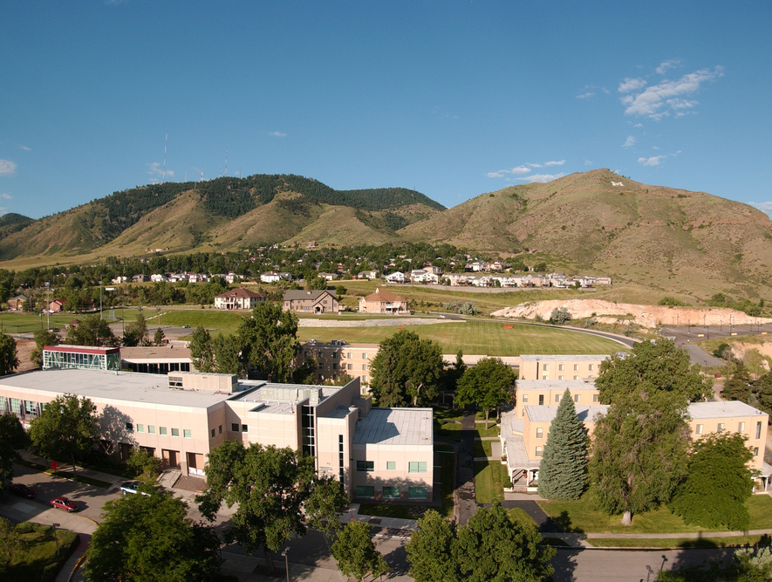
Colorado School of Mines
Computer Vision
Professor William Hoff
Dept of Computer Science
http://inside.mines.edu/~whoff/

Slide 2
Homography Transforms
Part 2

Slide 3
Good application: Creating a panorama
You can create a panorama, or “mosaic” from images that you take by rotating in place
You are effectively creating an image as if you had a camera with a very large field of view
What we do
Pick one image as a “reference” image
Compute the homography from each other image to that reference image
Warp each image to the space of the reference image
Stitch the images together, to make a panorama!

Slide 4
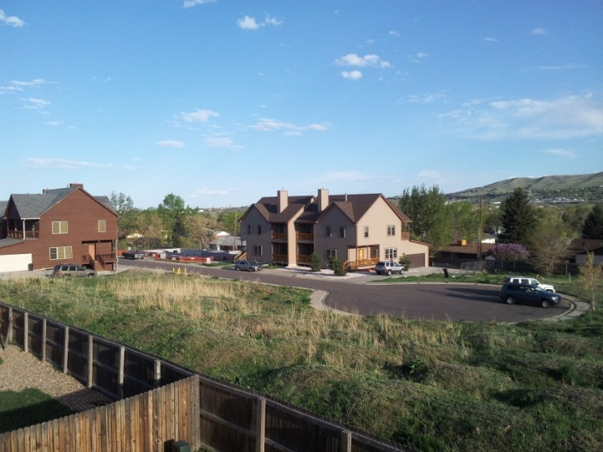
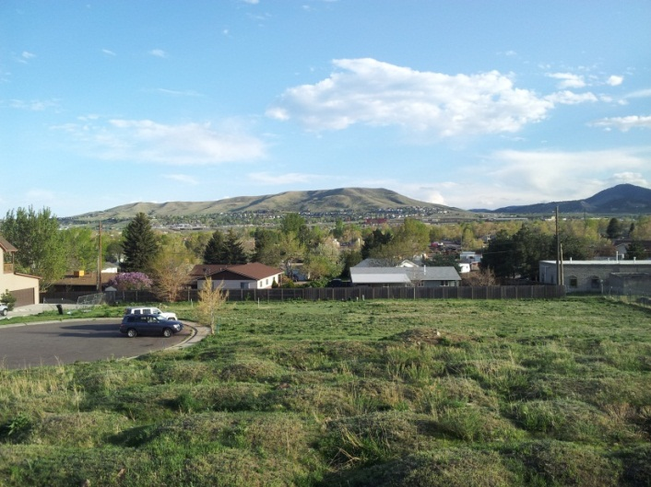
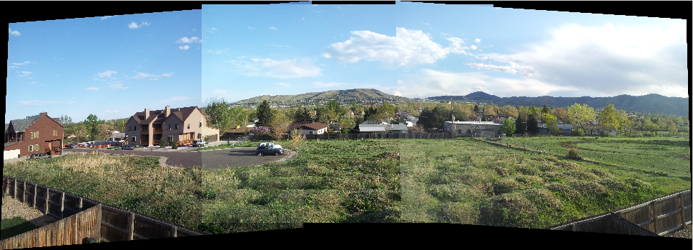
Example
from final project by CSM student Ryan Crawford (2012)
Input images
Note – blending should be done so that “seams” are not visible where the images are joined.
Registered images

Slide 5
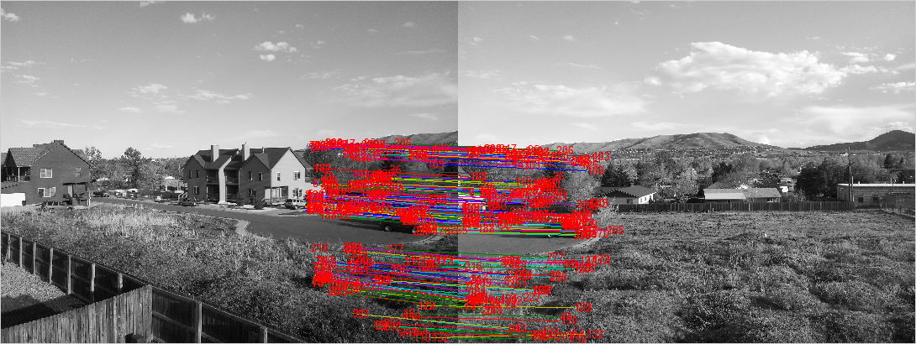
Control points
We need a set of corresponding points between the image and the reference image
Since the homography matrix has 8 degrees of freedom, we need at least 4 corresponding point pairs (more is better)
We solve for the homography matrix using least squares fitting
For now, we’ll pick corresponding points by hand, but later we will find them automatically
Automaticallymatching points

Slide 6
Pavilion Example – make a panorama
The images below were taken with a camera that has rotated (but not translated)
A projective transform (homography) can align the images so they can be merged into a panorama, as if they were all taken by the camera in the center position
Strategy: find a projective transform to register the left image to the center image, and also a projective transform to register the right image to the center image.
pavilionLeft.jpg
pavilionCenter.jpg
pavilionRight.jpg

Slide 7
Corresponding points
We need to find corresponding points between left-center, and center-right
You can use any tool that displays (x,y) coordinates for your mouse click, such as matplotlib’s “imshow”
However, I’ll show an easier program on the next slides
This program lets you click on two images
It uses a mouse “callback” function
It displays the points that you clicked on
You can then copy these points to another program

Slide 8
image_file_names = ["pavilionLeft.jpg", "pavilionCenter.jpg", "pavilionRight.jpg"] def main(): bgr_A = cv2.imread(image_file_names[0]) # Read images bgr_B = cv2.imread(image_file_names[1]) # Create two lists. The (x,y) points go in these lists. ptsA = [] ptsB = [] # Display images. displayA = bgr_A.copy() displayB = bgr_B.copy() create_named_window("Image A", displayA) create_named_window("Image B", displayB) cv2.imshow("Image A", displayA) cv2.imshow("Image B", displayB) # Assign the mouse callback function, which collects (x,y) points. cv2.setMouseCallback("Image A", on_mouse=get_xy, param=("Image A", displayA, ptsA)) cv2.setMouseCallback("Image B", on_mouse=get_xy, param=("Image B", displayB, ptsB)) # Loop until user hits the ESC key. print("Click on points. Hit ESC to exit.") while True: if cv2.waitKey(100) == 27: # ESC is ASCII code 27 if not len(ptsA) == len(ptsB): print("Error: you need same number of points in both images!") else: break print("PtsA:", ptsA) # Print points to the console print("PtsB:", ptsB)
find_corresponding.py

Slide 9
Useful function
This function creates a “resizable” window for your image
If the image is really big, it scales the window size down to fit on your screen
It also assigns a callback function to the window
# Utility function to create an image window. def create_named_window(window_name, image): # WINDOW_NORMAL allows resize; use WINDOW_AUTOSIZE for no resize. cv2.namedWindow(window_name, cv2.WINDOW_NORMAL) h = image.shape[0] # image height w = image.shape[1] # image width # Shrink the window if it is too big (exceeds some maximum size). WIN_MAX_SIZE = 1000 if max(w, h) > WIN_MAX_SIZE: scale = WIN_MAX_SIZE / max(w, h) else: scale = 1 cv2.resizeWindow(winname=window_name, width=int(w * scale), height=int(h * scale))
create_named_window()

Slide 10
Mouse callback function
This function is called when there is a mouse event
It appends the (x,y) location of the mouse click to a list
It also displays the location of the click on the image in the window
# Mouse callback function. Appends the x,y location of mouse click to a list. def get_xy(event, x, y, flags, param): if event == cv2.EVENT_LBUTTONDOWN: window_name, image, point_list = param # Unpack parameters cv2.rectangle(image, pt1=(x-15, y-15), pt2=(x+15, y+15), color=(0,0,255), thickness=3) cv2.putText(image, str(len(point_list)), org=(x,y-15), color=(0,0,255), fontFace=cv2.FONT_HERSHEY_SIMPLEX, fontScale=1.5, thickness=2) cv2.imshow(window_name, image) point_list.append((x,y))
get_xy()

Slide 11
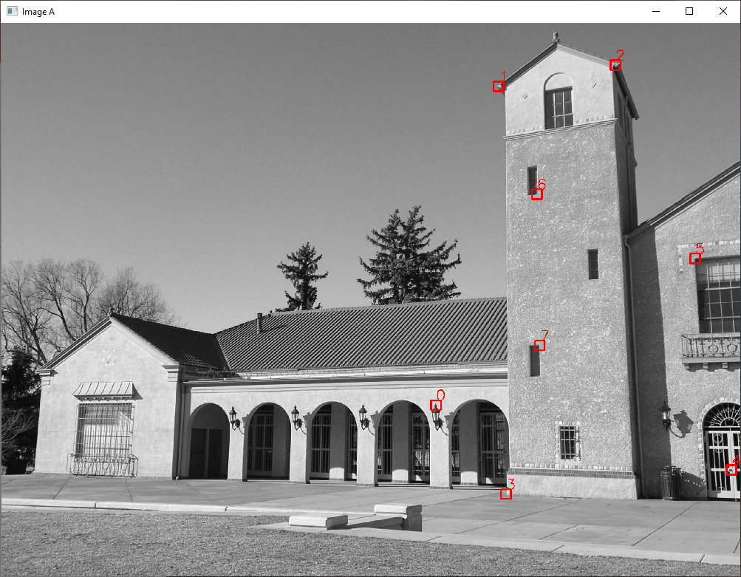
Demo – left image
Points on left image

Slide 12
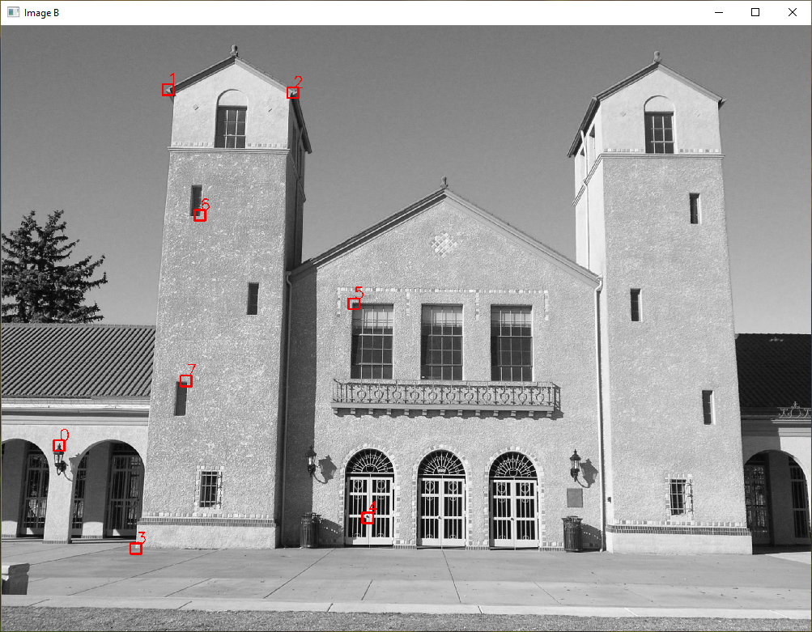
Demo – center image
Points on center image

Slide 13
Left-to-center points
The program prints these (x,y) points when you exit
These are corresponding points
You can copy them to another program
PtsA:
[(1345, 1183), (1542, 196), (1905, 128), (1564, 1457), (2260, 1382), (2150, 725), (1656, 526), (1663, 1000)]
PtsB:
[(162, 1183), (471, 185), (825, 187), (379, 1476), (1031, 1389), (992, 785), (562, 537), (523, 1007)]

Slide 14
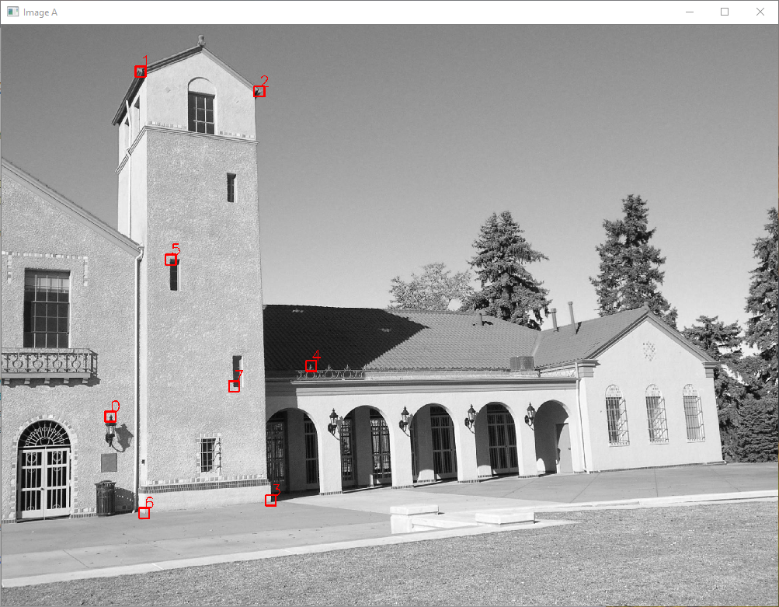
Demo – right image
Points on right image

Slide 15
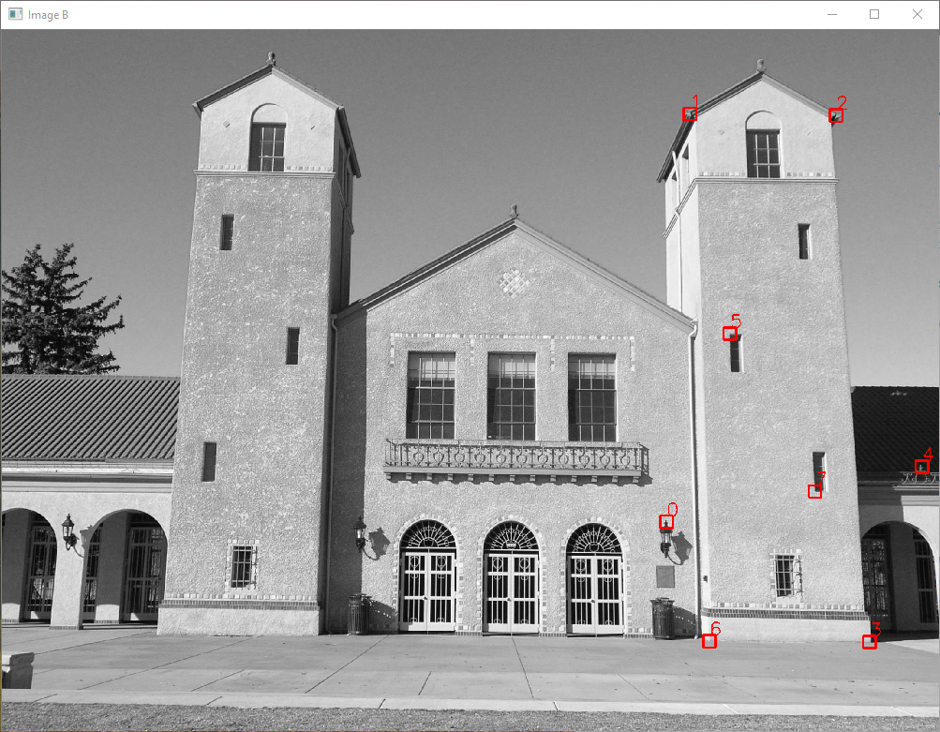
Demo – center image
Points on center image

Slide 16
Right-to-center points
The program prints these (x,y) points when you exit
These are corresponding points
You can copy them to another program
PtsA:
[(320, 1153), (409, 137), (759, 196), (793, 1400), (912, 1004), (498, 691), (420, 1437), (684, 1064)]
PtsB:
[(1622, 1201), (1679, 205), (2036, 208), (2118, 1494), (2246, 1066), (1777, 741), (1727, 1492), (1985, 1126)]

Slide 17
Calculate homographies, warp images
image_file_names = ["pavilionLeft.jpg", "pavilionCenter.jpg", "pavilionRight.jpg"] def main(): bgr_img0 = cv2.imread("pavilionLeft.jpg") bgr_img1 = cv2.imread("pavilionCenter.jpg") bgr_img2 = cv2.imread("pavilionRight.jpg") input_image_height = bgr_img1.shape[0] input_image_width = bgr_img1.shape[1] # Get corresponding points between images 0 and 1. pts0 = np.array( [(1345, 1183), (1542, 196), (1905, 128), (1564, 1457), (2260, 1382), (2150, 725), (1656, 526), (1663, 1000)] ) pts1 = np.array( [(162, 1183), (471, 185), (825, 187), (379, 1476), (1031, 1389), (992, 785), (562, 537), (523, 1007)] ) # Find homography between image 0 and image 1.
H_0_1, _ = cv2.findHomography(pts0, pts1) # Map image 0 to the output image. bgr_output0 = cv2.warpPerspective(bgr_img0, H_0_1, (input_image_width, input_image_height)) create_named_window("Output 0", bgr_output0) cv2.imshow("Output 0", bgr_output0) # Get corresponding points between images 2 and 1. pts2 = np.array( [(320, 1153), (409, 137), (759, 196), (793, 1400), (912, 1004), (498, 691), (420, 1437), (684, 1064)] ) pts1 = np.array( [(1622, 1201), (1679, 205), (2036, 208), (2118, 1494), (2246, 1066), (1777, 741), (1727, 1492), (1985, 1126)] )
# Find homography between image 2 and image 1. H_2_1, _ = cv2.findHomography(pts2, pts1) # Map image 2 to the output image. bgr_output2 = cv2.warpPerspective(bgr_img2, H_2_1, (input_image_width, input_image_height))
create_named_window("Output 2", bgr_output2) cv2.imshow("Output 2", bgr_output2)

Slide 18
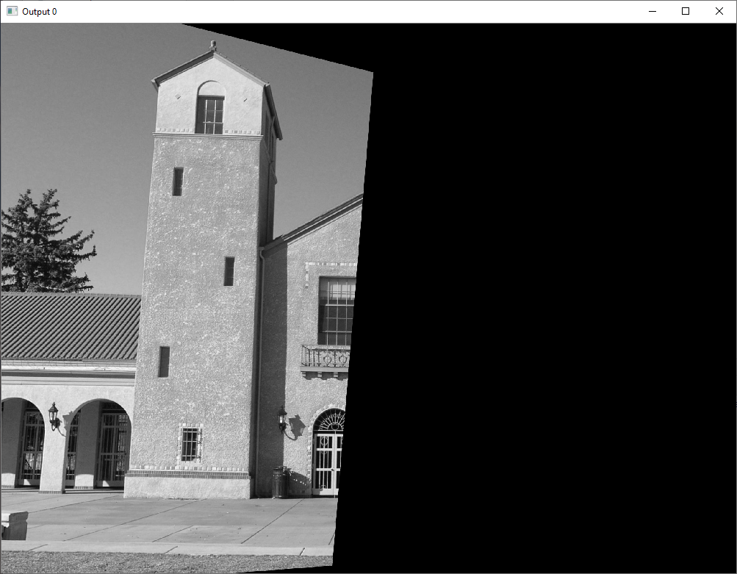
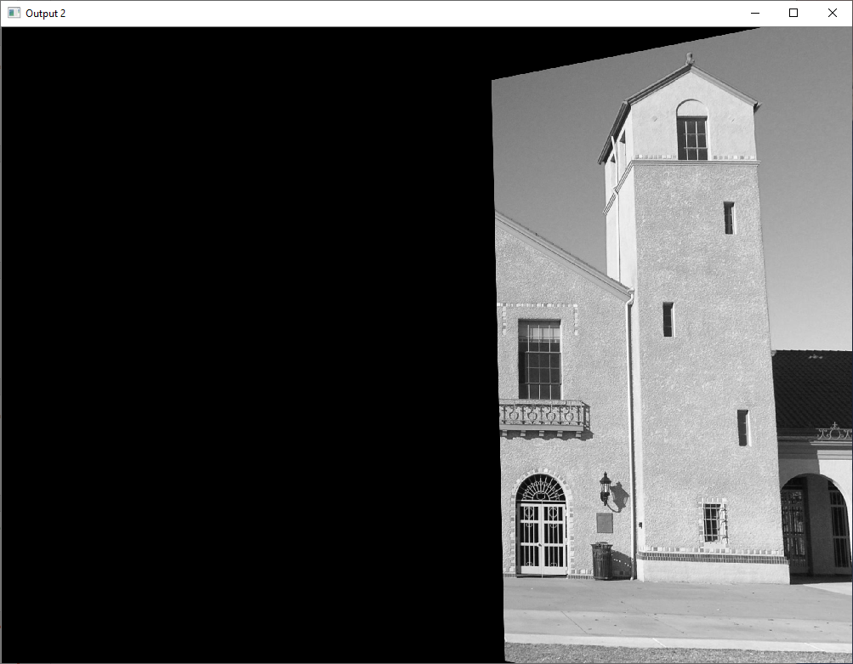
Warped left and right images are aligned with the center, but the output images are too small

Slide 19
Setting output image size
Let’s make the desired output image width 3 times the width of the input images
W
W
W
The points in the center image should be shifted by +W in the horizontal (x) direction

Slide 20
Modified program
# The desired output image combines images 0,1, and 2. # Let's make it 3 times the width of the input images. output_image_height = input_image_height output_image_width = input_image_width * 3 # Get corresponding points between images 0 and 1. pts0 = np.array( [(1345, 1183), (1542, 196), (1905, 128), (1564, 1457), (2260, 1382), (2150, 725), (1656, 526), (1663, 1000)] ) pts1 = np.array( [(162, 1183), (471, 185), (825, 187), (379, 1476), (1031, 1389), (992, 785), (562, 537), (523, 1007)] ) # Specify where the destination points are in the output image. pts_output = pts1 pts_output[:,0] += input_image_width # Find homography between image 0 and the output image. H_0_output, _ = cv2.findHomography(pts0, pts_output) # Get corresponding points between images 2 and 1. pts2 = np.array( [(320, 1153), (409, 137), (759, 196), (793, 1400), (912, 1004), (498, 691), (420, 1437), (684, 1064)] ) pts1 = np.array( [(1622, 1201), (1679, 205), (2036, 208), (2118, 1494), (2246, 1066), (1777, 741), (1727, 1492), (1985, 1126)] ) # Specify where the destination points are in the output image. pts_output = pts1 pts_output[:,0] += input_image_width # Find homography between image 2 and the output image. H_2_output, _ = cv2.findHomography(pts2, pts_output) # Map image 0 to the output image. bgr_output0 = cv2.warpPerspective(bgr_img0, H_0_output, (output_image_width, output_image_height)) # Map image 1 to the output image (just copy it to the middle third). bgr_output1 = np.zeros((output_image_height, output_image_width, 3), dtype=np.uint8) bgr_output1[:, input_image_width:2*input_image_width, :] = bgr_img1 # Map image 2 to the output image. bgr_output2 = cv2.warpPerspective(bgr_img2, H_2_output, (output_image_width, output_image_height))

Slide 21
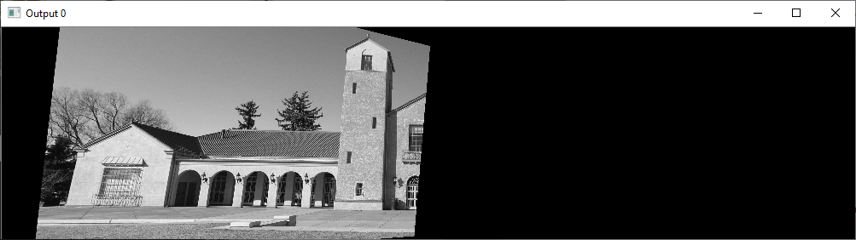
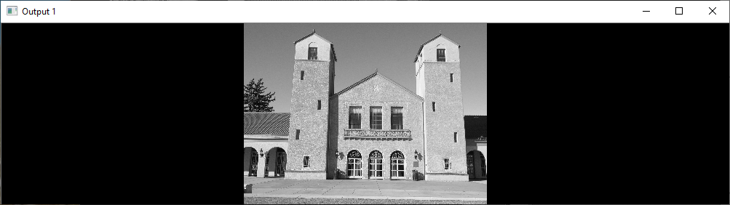
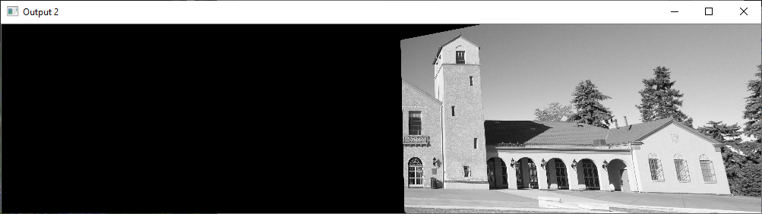

Slide 22
Blending images together
For pixels where two images overlap, the blended image should be an average of the pixels
For pixels where only one image has a valid value, just use that value
We’ll assume that a value of zero indicates an unknown value
Blue points: use that value in the output
Green points: average the values in the output

Slide 23

Creating a “mask” image
Given an input image, create a binary image that has 1 if the input image has a nonzero value there
Since these are color images, check all channels (red, green, blue) for nonzero values
# Create masks for pixels that are not zero. A_mask = np.sum(A, axis=2) > 0
Mask for left image

Slide 24
Mask logic, for two images
Create masks for image A and image B
Combine masks
A_only = A_mask & ~B_mask
B_only = B_mask & ~A_mask
A_and_B = A_mask & B_mask
Load output pixels
Use values from A where A_only is true
Use values from B where B_only is true
Average the values from A and B where A_and_B is true

Slide 25
# Fuse two color images. Assume that zero indicates an unknown value. # At pixels where both values are known, the output is the average of the two. # At pixels where only one is known, the output uses that value. def fuse_color_images(A, B): assert(A.ndim == 3 and B.ndim == 3) assert(A.shape == B.shape) # Allocate result image. C = np.zeros(A.shape, dtype=np.uint8) # Create masks for pixels that are not zero. A_mask = np.sum(A, axis=2) > 0 B_mask = np.sum(B, axis=2) > 0 # Compute regions of overlap. A_only = A_mask & ~B_mask B_only = B_mask & ~A_mask A_and_B = A_mask & B_mask C[A_only] = A[A_only] C[B_only] = B[B_only] C[A_and_B] = 0.5 * A[A_and_B] + 0.5 * B[A_and_B] return C
fuse_color_images()

Slide 26
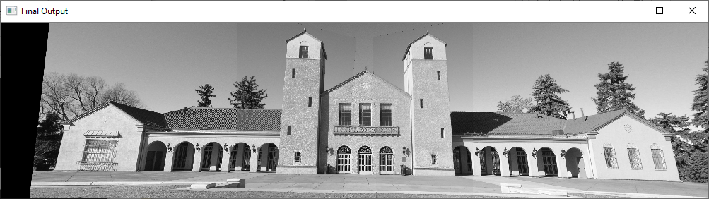
Combine all 3 images
# Combine the images. bgr_output = np.zeros((output_image_height, output_image_width, 3), dtype=np.uint8) bgr_output = fuse_color_images(bgr_output, bgr_output0) bgr_output = fuse_color_images(bgr_output, bgr_output1) bgr_output = fuse_color_images(bgr_output, bgr_output2) create_named_window("Final Output", bgr_output) cv2.imshow("Final Output", bgr_output)
Note how straight lines on the building are straight in the image

